Slide 1
Resources of Open Data
Tiiu Tarkpea
Data Librarian
"Open licenses, open content, open data: tools for developing digital humanities", Nov 1–3, 2017

Slide 2

Workshop outline
Open Science
…in Estonia
Data Discovery
Data repositories
Re3data
DataCite
OpenAIRE
Metadata
Max: APIs

Slide 3
Open Science?
Transparency in experimental methodology, observation, and collection of data.
Public availability and reusability of scientific data.
Public accessibility and transparency of scientific communication.
Using web-based tools to facilitate collaboration
Dan Gezelter
What, why, who, how, when, where?

Slide 4


Slide 5

Estonian Code of Conduct for Research Integrity (24.10.2017)
Planning of research
Conduct of research
Authorship, publishing and application of research results
Researcher in the research community
Observance, promotion and application of RI

Slide 6

Estonia’s strategic objective 2020:
The academic community is familiar with and accepts the principles of open science and open data.
Research data collected with the support of public funding are freely accessible and re-usable to all, if not restricted by legal requirements. Research data are preserved in open repositories which meet
certain standards and are made available at the earliest opportunity

Slide 7
Archive? Repository?
Repositories preserve, manage, and provide access to many types of digital materials in a variety of formats. Materials in online repositories are curated to enable search, discovery, and reuse. There must be sufficient control for the digital material to be authentic, reliable, accessible and usable on a continuing basis.
http://dictionary.casrai.org/Repository

Slide 8

Repositories can help you!
Search and find research data
Cite the data by supplying a persistent identifier
Use citation formatter
------------------------------------
Store your own data
Facilitate discovery of your data
Make data interoperable
Preserve data ≈ 10 years

Slide 9
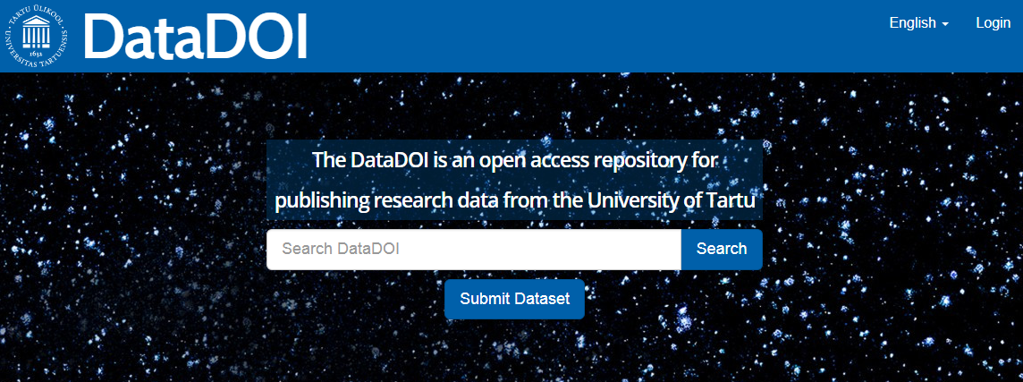
Put, get, use!
Universal (Dryad, Figshare, Zenodo)
Disciplinary-based (ArXiv.org, PubMed Central, GESIS, ICPSR)
National (UK Data Service, ANDS)
Institutional (DataDOI, TROLLING, QsarDB)

Slide 10
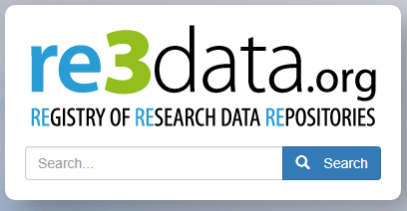
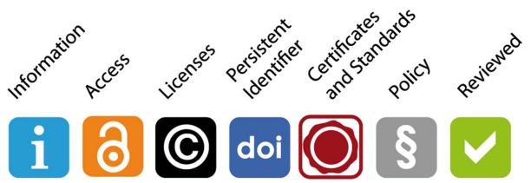
Re3data.org
Registry of Research Data Repositories
1957 research data repositories (27.10.2017)
Tutorial in Estonian and in English
Search and browse
Clear icon system

Slide 11
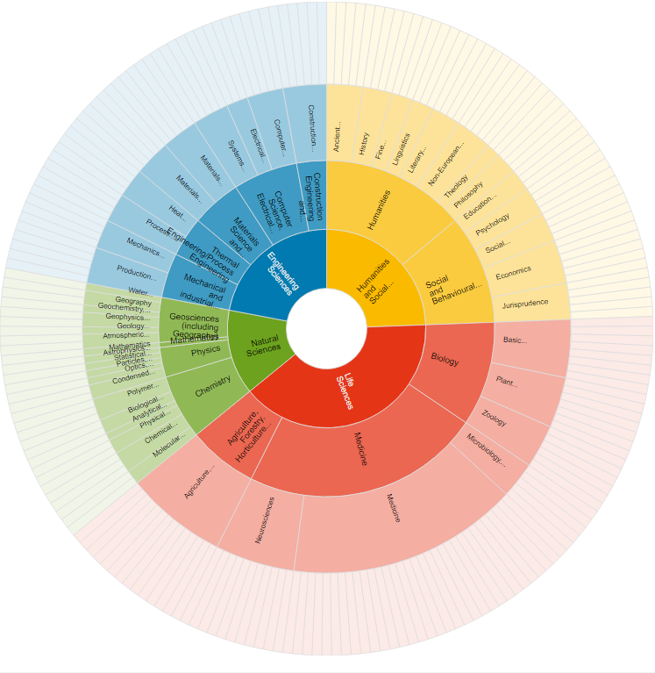
Let’s
have
a fun!
Let’s
find
data!

Slide 12
Re3data.org
Remember: you try to find a repository!
Browse: 1. Subject or Content type?
2. Graphical or text?
3. Filter?
Search: 1. Subject area or specific search?
2. Filter?
Try: linguistics!

Slide 13
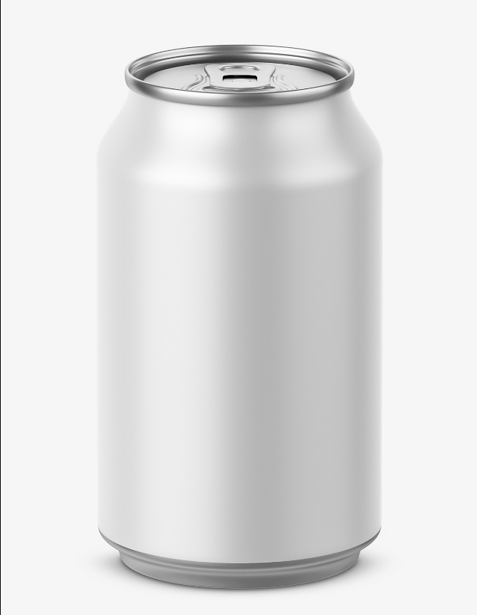



Metadata make sense of data!
Credit
Credit

Slide 14
DataCite Mandatory Metadata
Identifier - DOI
Creator – main researchers
Title
Publisher – datacenter
Publication Year – publicly available
Resource Type – dataset, text, code…
Resource Type General – image, software, workflow

Slide 15

DataCite
supports researchers to find, identify, and cite research data and other research objects
supports data centres by providing DOIs for datasets, workflows and standards.
supports journal publishers by enabling research articles to be linked to underlying data/objects
supports funding agencies by helping them understand the reach and impact of their funding

Slide 16
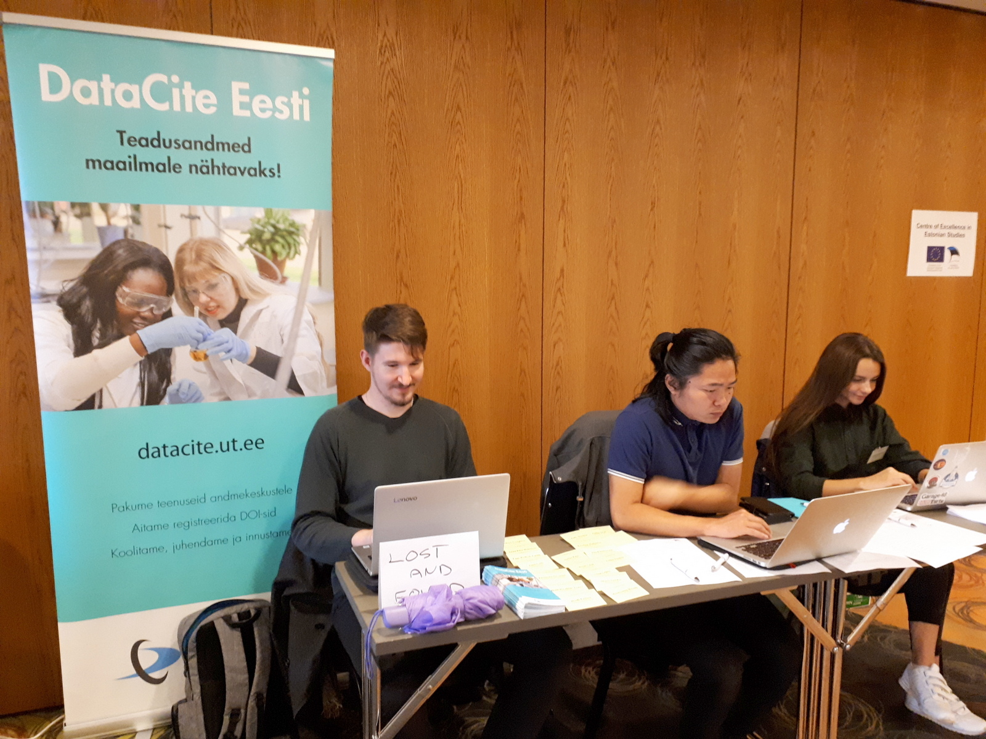
DataCite Estonia
Consortium of 4 universities:
UT, TUT, TU, EULS
Allocator: University of Tartu
Since 2015
Registers metadata
Assign DOI-s (492 391 estdoi 27.10.2017)
Free of charge for researchers of the universities

Slide 17
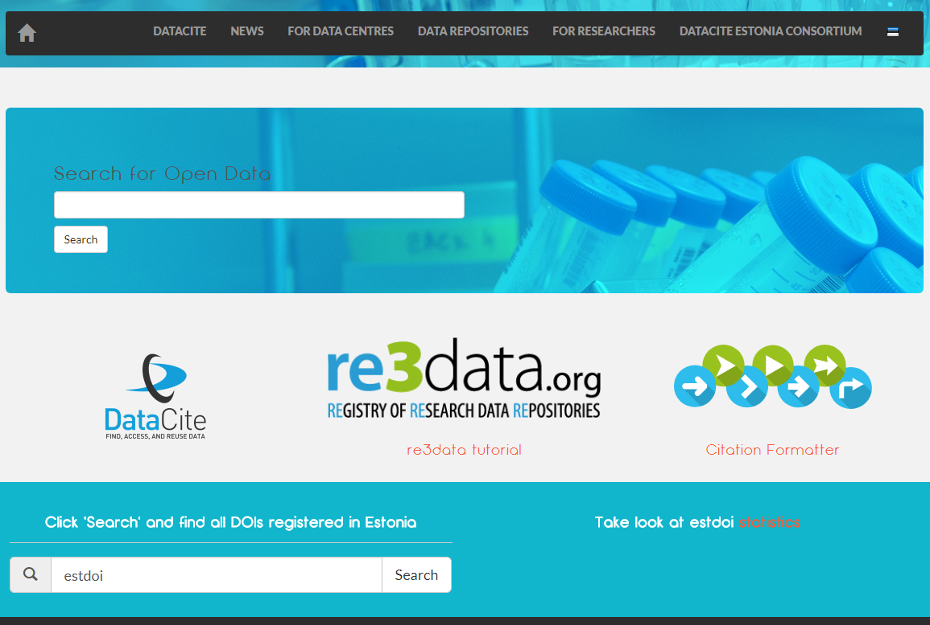
datacite.ut.ee

Slide 18
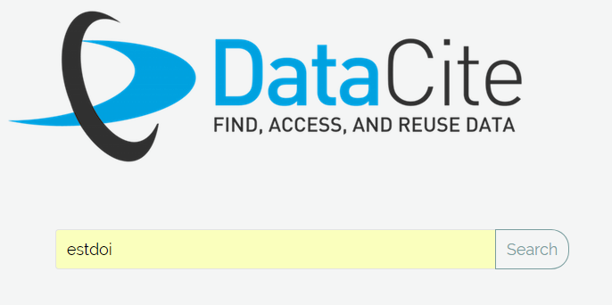
DataCite Search
https://search.datacite.org/
Based on metadata
Mandatory, Recommended, Optional MD
Limiters (based on R and O metadata)
Obtain statistics
Explore connections

Slide 19
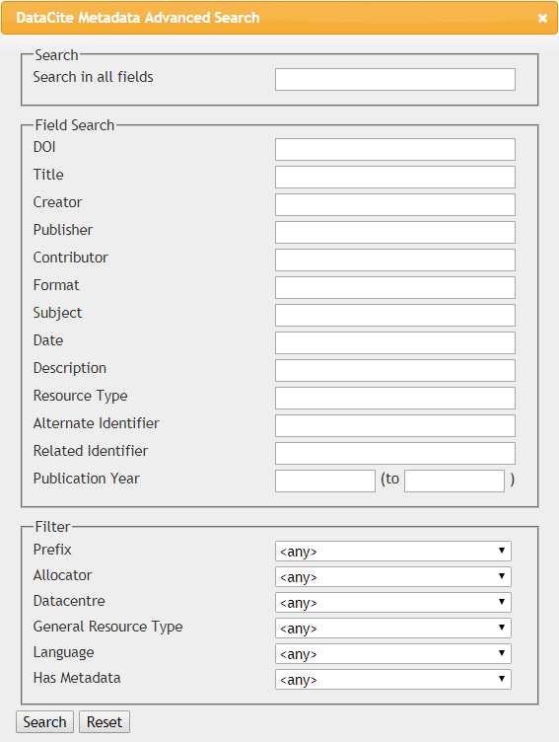
Back door for you!
Metadata search Beta
https://search.datacite.org/ui

Slide 20
Data Citation
Unique identification → route to access
Persistence of data and metadata
Data as evidence
Reproduction of research results
Credit and attribution to all contributers → reward
Impact of data
Publication + underlying data

Slide 21
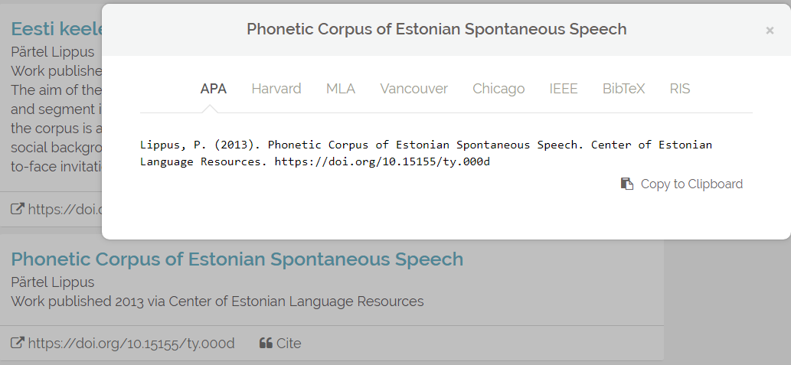
Try Citation formatter: paste DOI

Slide 22
OpenAIRE portal
Make European-funded research output available
Key infrastructure for reporting H2020’s scientific publications and data
Open research data will apply by default to all H2020 projects from 2017! (Possibility to opt out)
Zenodo, hosted by CERN, multidisciplinary repository
UT Library as NOAD

Slide 23

Zenodo - your one stop research shop!
Support the EC Open Data policy
Created by OpenAIRE and CERN
All fields of science
Upload files up to 50GB per dataset
FAIR Principles for research data
Zenodotus, the first librarian
of the Ancient Library of Alexandria,
father of the first recorded use of metadata

Slide 24
Other
OpenDOAR - The Directory of Academic Open Access Repositories
ROAR - Registry of Open Access Repositories
Public open data
https://www.opendatasoft.com/a-comprehensive-list-of-all-open-data-portals-around-the-world/

Slide 25
Research paper of the Future
The future paper may be more of a computational narrative - a rich 'compilation' of executable and reuseable text, code, data, materials, and methods - that in combination make transparent the entire data-to-claim process. OR it may also be a set of nanopublications - discrete claims founded on shared data and clearly disclosed methods and materials
Resource

Slide 26


OpenAIRE
Zenodo
=
H2020
Open
Data
is
norm!
Re3data
for
repositories
DataCite
=
DOI
Metadata!

Slide 27
Tiiu Tarkpea
Data Librarian
tiiu.tarkpea@ut.ee

